Slide 1
From Problems to Algorithms to Programs
CS 414, Spring 2017 (CRN: 55555)
Betsy Coleman
Lectures: Tue/Thu 12:40-2:00PM Kingsbury N328
Labs: Wed 10:10-11AM Kingsbury N218
Office: Kingsbury W243
Office Hours: Tue/Thu: 9:30-11AM
Email: betsy.coleman@cs.unh.edu
Web: http://cs.unh.edu/~cs414/

Slide 2
Computer Hardware
The term hardware refers to the computer’s physical components
A computer is not one device, but a system of devices
Major types of components include:
Central Processing Unit
Main memory
Secondary storage devices
Input devices
Output devices

Slide 3
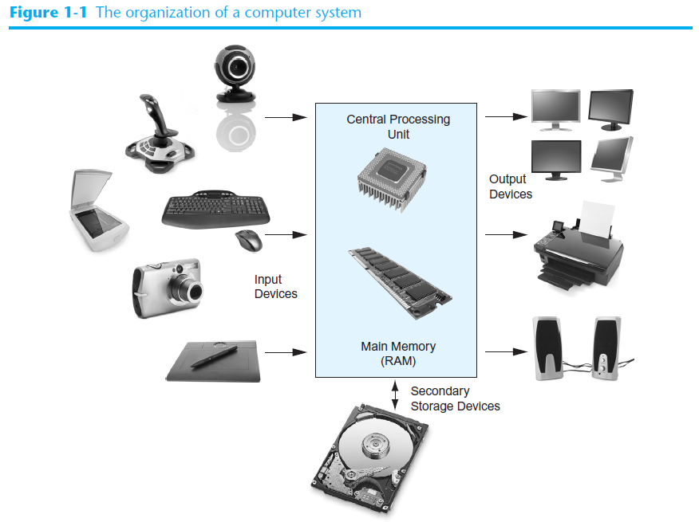
The Organization of a Computer System

Slide 4
The CPU
The central processing unit, or CPU, is the part of a computer that actually runs programs
The most important component
Without it, the computer could not run software
Fetches instructions one by one
A program is a set of instructions a computer’s CPU follows to perform a task
Instructions are stored in memory as binary numbers
A binary number is a sequence of 1s and 0s

Slide 5
Main Memory
Think of main memory as the computer’s work area
Holds instructions and data needed for programs that are currently running
Commonly known as random-access memory, or just RAM
CPU can quickly access data at any random location
Used as temporary storage
Contents are lost when power is turned off

Slide 6
Secondary Storage
Most common secondary storage device is the disk drive
Records data magnetically on a circular disk
Other types of secondary storage devices include:
External disk drives
Connects to one of the computer’s communication ports
USB drives
Small devices that plug into a computer’s USB port
Optical devices such as CDs and DVDs
Data is encoded using a series of pits on the disc surface

Slide 7
Memory/Storage Units
Binary ⬄ Decimal Conversion
Units of data/memory:
Bit (Binary Digit)
Byte
Memory word – number of bits viewed as single unit of information
32-bit word, 64-bit word

Slide 8
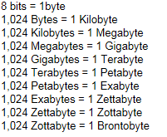
Memory/Storage Units
Storage Units
Byte 8 bits
Kilobyte (KB) 1024 bytes
2 **10 (greater than 10 **3)
Megabyte (MB) 1048576 bytes
2 **20 (greater than 10 **6)
Gigabyte (GB) greater than 10 **9
Terabyte (TB) greater than 10 **12

Slide 9
Memory/Storage Units
Floppy disk – 1.44 MB (2.0 MB)
CD – 680 MB
DVD (digital video drive) – 4. 7GB (4 layers)
Magnetic tape drive – Sequential access
Hard disk (built-in component, external)
http://highscalability.com/blog/2012/9/11/how-big-is-a-petabyte-exabyte-zettabyte-or-a-yottabyte.html
Directories, Files, File Structure

Slide 10
Input Devices
Input is any data the computer collects from the outside world
The device that collects and sends data to the computer is called an input device
Common input devices:
Keyboard
Mouse
Digital camera
Disk and optical drives can be input devices
If their data is retrieved and loaded into main memory

Slide 11
Output Devices
Output is any data the computer sends to the outside world
A sales report, list of names, graphic images, or a sound
Data is sent to an output device, which formats and presents it
Common output devices:
Monitor
Printer
Disk and optical drives can be output devices
If the CPU sends them data to be saved

Slide 12
Computer Software
Computer components – “hardware”
List of instructions to be executed on the hardware is called “software” (or “program”)
Operating System – Collection of computer programs that control the interaction between the user and computer hardware
O.S is loaded into RAM from disk at boot-time
Examples:
Unix, VMS, MS-DOS, OS/2 (command-line interface)
Macintosh OS, Windows (graphical user interface)

Slide 13
Computer Software
Functions of an O.S:
Execute commands from the user
Validate users and maintain security for access of information
Processor, Memory and Resource Management
Interpretation of input/output information
Data retrieval and storage on to secondary storage devices

Slide 14
Computer Software
Application Software
Programs to assist computer users in performing tasks
MS-WORD – Word processing application
Lotus 1-2-3 – Spreadsheet application
dBase, MS-Access – database management applications
Several applications are “bundled” with the o.s and available after the o.s install
Additional applications can be installed anytime
Application Software Vs System Software

Slide 15
What is a Program?
Computers can only follow instructions
A computer program is a set of instructions on how to solve a problem or perform a task
In order for a computer to compute someone’s gross pay, we must tell it to perform the steps on the following slide

Slide 16
Computing Gross Pay
This well-defined, ordered set of steps for solving a problem is called an algorithm

Slide 17
States and Transitions
Memory snapshots show program states
Store hours worked in memory
Store hourly pay rate in memory
Multiply hours worked by pay rate and store amount earned in memory
Program Starting State
hours worked | ??
hourly pay rate | ??
amount earned | ??
Snapshot after Step 3
hours worked | 20
hourly pay rate | ??
amount earned | ??
Snapshot after Step 6
hours worked | 20
hourly pay rate | 25
amount earned | ??
Snapshot after Step 7
hours worked | 20
hourly pay rate | 25
amount earned | 500

Slide 18
Programming Languages
The steps in an algorithm must be stated in a form the computer understands
The CPU processes a series of 1s and 0s called machine language instructions
This is a tedious and difficult format for people
Programming languages allow us to use words instead of numbers
Special software called a compiler converts the programming language statements to machine language instructions

Slide 19
Popular Programming Languages

Slide 20
What is a Program Made Of?
Keywords (Reserved Words)
Words with special meaning that make up a high-level programming language, cannot be used for any other purpose
Operators
Special symbols that perform various operations on data
Variables
Used to store data in memory, named by the programmer
Syntax
Set of rules
Similar to the syntax (rules) of a spoken language, such as English, but must be strictly followed
If even a single syntax error appears in a program, it will not compile or execute

Slide 21
What is a Program Made Of?
Statements
Instructions made up of keywords, variables, and operators.
Called source code, or simply code
Functions
Set of programming statements that perform a specific task
Comments (Remarks)
Ignored when the program runs, help human reader understand the purpose of programming statements
In Python, any statement that begins with an double quote(″)

Slide 22
Creating Computer Programs
Steps to creating a successful program
Edit, Compile, Link (This depends on the language used – Python is interpreted)
Editor – Word processor (Source File)
Compiler – Converts high level language into machine code (Object File)
Link – Resolves references made to other object files (Executable File)

Slide 23
Software Development Method
Programming is a “problem-solving” activity
Steps to programming methodology:
Specify the problem requirements (state the problem)
Analyze the problem
Design the algorithm to solve the problem
Implement the algorithm to create a program
Test and verify the completed program
Maintain and update the program

Slide 24
Software Development Method
Steps 1 & 2 are very important – else you will be solving the wrong problem!
Example:
Problem: Calculate and display the volume of a cylinder given its base radius and height in centimeters
Problem Inputs: radius of base, height (in cm)
Problem Outputs: volume of cylinder (in cubic cm)
Develop the relationship between inputs & outputs, in this case it’s the formula that calculates the volume

Slide 25
Software Development Method
Step 3 – Algorithm Design
Develop a list of steps called an algorithm to solve the problem
Most difficult part of the problem-solving process
Top-down approach – list major steps or sub problems that need to be solved, solve each sub problem, refine algorithm
Typical algorithm:
Get the data
Perform computations
Display results

Slide 26
Software Development Method
Step 4 – Implementation
Choose a language to implement the algorithm and write the program
Each algorithmic step contributes to creating the program
Step 5 – Testing
Step 6 – Maintenance and update

Slide 27
Graphical User Interfaces
The people who use a program are known as users
The part of a program that users interact with is known as the user interface
A graphical user interface or GUI (pronounced gooey) consists of one or more windows
A window is a rectangular area that contains other visual elements such as text and buttons

