Slide 1
Reading and Writing Files
The function f=open(filename, mode) opens a file for reading or writing.
mode can be:
  “r” – Reading
  “w”- Writing
  “a”- Append
  “r+”- Open for both reading and writing.
  “b” – Open the file in binary mode (only in Windows)

Slide 2
File Input/Output
input_file = open(“in.txt")
output_file = open(“out.txt", "w")
for line in input_file:
output_file.write(line)
“w” = “write mode”
“a” = “append mode”
“wb” = “write in binary”
“r” = “read mode” (default)
“rb” = “read in binary”
“U” = “read files with Unix
or Windows line endings”

Slide 3
Reading a file
s = f.read(size)
  It will read size characters from the file and place it in string s.
s = f.read()
  It reads the entire file and places it in string s.
s = f.readline()
  It reads a single line from the file.
l = f.readlines()
  It returns a list with all the lines in the file.

Slide 4
Writing to a file
f.write(s)
  It write string s to file f.
f.seek(pos)
  Changes the fileposition to pos
f.close()
  It closes the file

Slide 5
Reading Files
name = open("filename")
  opens the given file for reading, and returns a file object
name.read() - file's entire contents as a string
name.readline() - next line from file as a string
name.readlines() - file's contents as a list of lines
  the lines from a file object can also be read using a for loop
>>> f = open("hours.txt")
>>> f.read()
'123 Susan 12.5 8.1 7.6 3.2\n
456 Brad 4.0 11.6 6.5 2.7 12\n
789 Jenn 8.0 8.0 8.0 8.0 7.5\n'

Slide 6
File Input Template
A template for reading files in Python:
name = open("filename")
for line in name:
statements
>>> input = open("hours.txt")
>>> for line in input:
... print(line.strip()) # strip() removes \n
123 Susan 12.5 8.1 7.6 3.2
456 Brad 4.0 11.6 6.5 2.7 12
789 Jenn 8.0 8.0 8.0 8.0 7.5

Slide 7
Exercise
Write a function input_stats that accepts a file name as a parameter and that reports the longest line in the file.
  example input file, carroll.txt:
  Beware the Jabberwock, my son,
  the jaws that bite, the claws that catch,
  Beware the JubJub bird and shun
  the frumious bandersnatch.
  expected output:
>>> input_stats("carroll.txt")
longest line = 42 characters
the jaws that bite, the claws that catch,

Slide 8
Exercise Solution
  def input_stats(filename):
  input = open(filename)
  longest = ""
  for line in input:
  if len(line) > len(longest):
  longest = line
  print("Longest line =", len(longest))
  print(longest)

Slide 9
String Splitting
split breaks a string into tokens that you can loop over.
  name.split() # break by whitespace
  name.split(delimiter) # break by delimiter
join performs the opposite of a split
  delimiter.join(list of tokens)
>>> name = "Brave Sir Robin"
>>> for word in name.split():
... print(word)
Brave
Sir
Robin
>>> "LL".join(name.split("r"))
'BLLave SiLL Robin

Slide 10
Splitting into Variables
If you know the number of tokens, you can split them directly into a sequence of variables.
  var1, var2, ..., varN = string.split()
may want to convert type of some tokens: type(value)
>>> s = "Jessica 31 647.28"
>>> name, age, money = s.split()
>>> name
'Jessica'
>>> int(age)
31
>>> float(money)
647.28

Slide 11
Tokenizing File Input
Use split to tokenize line contents when reading files.
  You may want to type-cast tokens: type(value)
>>> f = open("example.txt")
>>> line = f.readline()
>>> line
'hello world 42 3.14\n'
>>> tokens = line.split()
>>> tokens
['hello', 'world', '42', '3.14']
>>> word = tokens[0]
'hello'
>>> answer = int(tokens[2])
42
>>> pi = float(tokens[3])
3.14

Slide 12
Exercise
Suppose we have this hours.txt data:
  123 Suzy 9.5 8.1 7.6 3.1 3.2
  456 Brad 7.0 9.6 6.5 4.9 8.8
  789 Jenn 8.0 8.0 8.0 8.0 7.5
Compute each worker's total hours and hours/day.
  Assume each worker works exactly five days.
  Suzy ID 123 worked 31.4 hours: 6.3 / day
  Brad ID 456 worked 36.8 hours: 7.36 / day
  Jenn ID 789 worked 39.5 hours: 7.9 / day

Slide 13
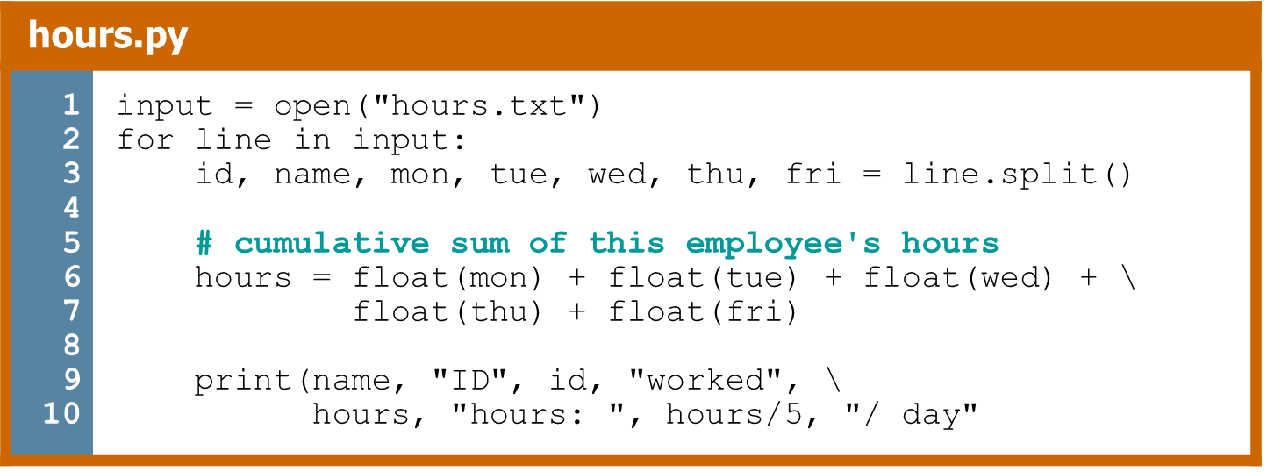
Exercise Answer

Slide 14
Writing Files
name = open("filename", "w")
name = open("filename", "a")
  opens file for write (deletes previous contents), or
  opens file for append (new data goes after previous data)
name.write(str) - writes the given string to the file
name.close() - saves file once writing is done
>>> out = open("output.txt", "w")
>>> out.write("Hello, world!\n")
>>> out.write("How are you?")
>>> out.close()
>>> open("output.txt").read()
'Hello, world!\nHow are you?'

Slide 15
Exceptions
In python the best way to handle errors is with exceptions.
Exceptions separates the main code from the error handling making the program easier to read.
try:
statements
except:
error handling

Slide 16
Exceptions
Example:
import sys
try:
f = open('myfile.txt')
s = f.readline()
i = int(s.strip())
except IOError as (errno, strerror):
print "I/O error({0}): {1}".format(errno, strerror)
except ValueError:
print "Could not convert data to an integer."
except:
print "Unexpected error:", sys.exc_info()[0]
raise

Slide 17
The finally statement
The finally: statement is executed under all circumstances even if an exception is thrown.
Cleanup statements such as closing files can be added to a finally stetement.

Slide 18
Finally statement
import sys
try:
f = open('myfile.txt')
s = f.readline()
i = int(s.strip())
except IOError as (errno, strerror):
print "I/O error({0}): {1}".format(errno, strerror)
except ValueError:
print "Could not convert data to an integer."
except:
print "Unexpected error:", sys.exc_info()[0]
finally:
f.close() # Called with or without exceptions.

Slide 19
Error Handling With Exceptions
Exceptions are used to deal with extraordinary errors (‘exceptional ones’).
Typically these are fatal runtime errors (“crashes” program)
Example: trying to open a non-existent file
Basic structure of handling exceptions
  try:
  Attempt something where exception error may happen
  except <exception type>:
  React to the error
  else: # Not always needed
  What to do if no error is encountered
  finally: # Not always needed
  Actions that must always be performed

Slide 20
Exceptions: File Example
Name of the online example: file_exception.py
Input file name: Most of the previous input files can be used e.g. “input1.txt”
inputFileOK = False
while (inputFileOK == False):
try:
inputFileName = input("Enter name of input file: ")
inputFile = open(inputFileName, "r")
except IOError:
print("File", inputFileName, "could not be opened")
else:
print("Opening file", inputFileName, " for reading.")
inputFileOK = True
for line in inputFile:
sys.stdout.write(line)
print ("Completed reading of file", inputFileName)
inputFile.close()
print ("Closed file", inputFileName)

Slide 21
Exceptions: File Example (2)
# Still inside the body of the while loop (continued)
finally:
if (inputFileOK == True):
print ("Successfully read information from file",
inputFileName)
else:
print ("Unsuccessfully attempted to read information
from file", inputFileName)

Slide 22


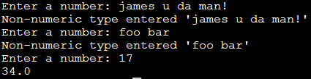
Exception Handling: Keyboard Input
Name of the online example: exception_validation.py
inputOK = False
while (inputOK == False):
try:
num = input("Enter a number: ")
num = float(num)
except ValueError: # Can’t convert to a number
print("Non-numeric type entered '%s'" %num)
else: # All characters are part of a number
inputOK = True
num = num * 2
print(num)

Slide 23
Example of using Files
>>> f=open("f.py","r")
>>> s=f.read()
>>> print(s)
def fac(n):
r=1
for i in range(1,n+1):
r = r * i
return r
import sys
n = int(sys.argv[1])
print("The factorial of ", n, " is ", fac(n))
>>> f.close()
>>>

Slide 24
Predefined cleanup actions
The with statement will automatically close the file once it is no longer in use.
with open("myfile.txt") as f:
for line in f:
print line
After finishing the with statement will close the file.

Slide 25
Useful links
https://docs.python.org/2/library/stdtypes.html#file-objects
https://docs.python.org/2/tutorial/inputoutput.html#reading-and-writing-files
http://cmdlinetips.com/2011/08/three-ways-to-read-a-text-file-line-by-line-in-python/
https://www.slideshare.net/Felix11H/python-file-operations-data-parsing-40992696

