Slide 1
Overview of OOP Terminology

Slide 2
Class:
A user-defined prototype for an object that defines a set of attributes that characterize any object of the class. The attributes are data members (class variables and instance variables) and methods, accessed via dot notation.

Slide 3
Class variable:
A variable that is shared by all instances of a class. Class variables are defined within a class but outside any of the class's methods. Class variables are not used as frequently as instance variables are.

Slide 4
Data member:
A class variable or instance variable that holds data associated with a class and its objects.

Slide 5
Function overloading:
The assignment of more than one behavior to a particular function. The operation performed varies by the types of objects or arguments involved.

Slide 6
Instance variable:
A variable that is defined inside a method and belongs only to the current instance of a class.

Slide 7
Inheritance:
The transfer of the characteristics of a class to other classes that are derived from it.

Slide 8
Instance:
An individual object of a certain class. An object obj that belongs to a class Circle, for example, is an instance of the class Circle.

Slide 9
Instantiation:
The creation of an instance of a class.

Slide 10
Method :
A special kind of function that is defined in a class definition.

Slide 11
Object:
A unique instance of a data structure that's defined by its class. An object comprises both data members (class variables and instance variables) and methods.

Slide 12
Operator overloading:
The assignment of more than one function to a particular operator.

Slide 13
Classes
A class defines the data and behavior of an object.
A class defines what all instances of that class know and can do.
Objects are instances of classes in many object-oriented languages.
Including Smalltalk, Java, JavaScript, and Python.
Notes:
Thanks to John Sanders of Suffolk University for contributions to these slides!
https://www.google.com/url?sa=t&rct=j&q=&esrc=s&source=web&cd=5&cad=rja&uact=8&ved=0ahUKEwi0n5-9jI7TAhXi1IMKHV3iCLcQFggxMAQ&url=http%3A%2F%2Fcoweb.cc.gatech.edu%2FmediaComp-teach%2Fuploads%2F55%2FCh16-ObjectOrientedProgramming-3e.ppt&usg=AFQjCNHrK96V1E8L4m-gxpQURhOSEPrMEg&sig2=XG3x5ecaNtAXfSZHp-5h6w&bvm=bv.151426398,d.eWE
coweb.cc.gatech.edu/mediaComp-teach/.../Ch16-ObjectOrientedProgramming-3e.ppt

Slide 14
Classes
class name:
"documentation"
statements
-or-
class name(base1, base2, ...):
...
Most, statements are method definitions:
def name(self, arg1, arg2, ...):
...
May also be class variable assignments

Slide 15
Defining an object
Objects know things.
Data that is internal to the object.
We often call those instance variables.
Objects can do things.
Behavior that is internal to the object.
We call functions that are specific to an object methods.
But you knew that one already.
We access both of these using dot notation
object.variable
object.method()

Slide 16
Class Declaration

Slide 17
Class Attributes
Attributes assigned at class declaration should always be immutable

Slide 18
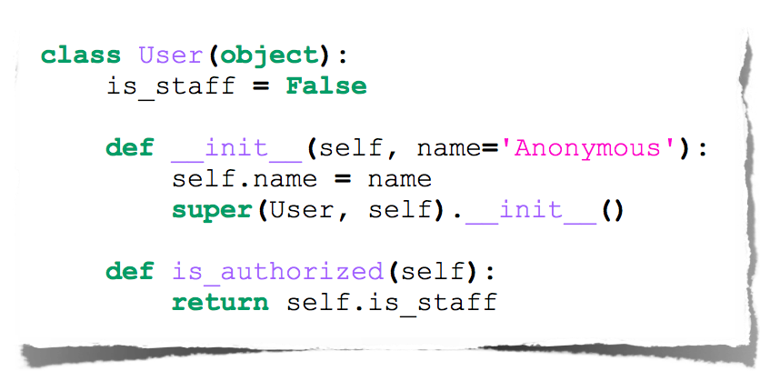
Class Methods

Slide 19
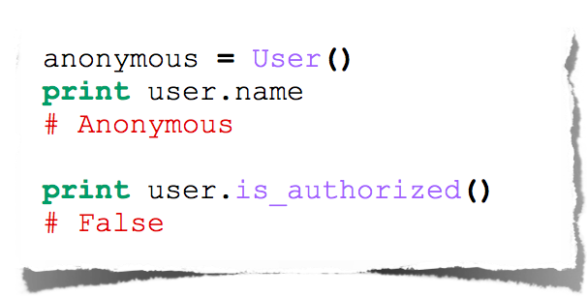
Class Instantiation & Attribute Access

Slide 20
Class Inheritance

Slide 21
Python’s Way
No interfaces
No real private attributes/functions
Private attributes start (but do not end) with double underscores.
Special class methods start and end with double underscores.
__init__, __doc__, __cmp__, __str__

Slide 22
Example Class
class Stack:
"A well-known data structure…"
def __init__(self): # constructor
self.items = []
def push(self, x):
self.items.append(x) # the sky is the limit
def pop(self):
x = self.items[-1] # what happens if it’s empty?
del self.items[-1]
return x
def empty(self):
return len(self.items) == 0 # Boolean result

Slide 23
Using Classes
To create an instance, simply call the class object:
x = Stack() # no 'new' operator!
To use methods of the instance, call using dot notation:
x.empty() # -> 1
x.push(1) # [1]
x.empty() # -> 0
x.push("hello") # [1, "hello"]
x.pop() # -> "hello" # [1]
To inspect instance variables, use dot notation:
x.items # -> [1]

Slide 24
Subclassing
class FancyStack(Stack):
"stack with added ability to inspect inferior stack items"
def peek(self, n):
"peek(0) returns top; peek(-1) returns item below that; etc."
size = len(self.items)
assert 0 <= n < size # test precondition
return self.items[size-1-n]

Slide 25
Subclassing (2)
class LimitedStack(FancyStack):
"fancy stack with limit on stack size"
def __init__(self, limit):
self.limit = limit
FancyStack.__init__(self) # base class constructor
def push(self, x):
assert len(self.items) < self.limit
FancyStack.push(self, x) # "super" method call

Slide 26
Class / Instance Variables
class Connection:
verbose = 0 # class variable
def __init__(self, host):
self.host = host # instance variable
def debug(self, v):
self.verbose = v # make instance variable!
def connect(self):
if self.verbose: # class or instance variable?
print "connecting to", self.host

Slide 27
Instance Variable Rules
On use via instance (self.x), search order:
(1) instance, (2) class, (3) base classes
this also works for method lookup
On assignment via instance (self.x = ...):
always makes an instance variable
Class variables "default" for instance variables
But...!
mutable class variable: one copy shared by all
mutable instance variable: each instance its own

Slide 28
Example on Making a Class from Scratch: SlideShow
Let’s build a program to show a slide show.
It shows a picture.
Then plays a corresponding sound.
We’ll use the introduced-but-never-used blockingPlay() to make the execution wait until the sound is done.

Slide 29
Slideshow
def playslideshow():
pic = makePicture(getMediaPath("barbara.jpg"))
snd = makeSound(getMediaPath("bassoon-c4.wav"))
show(pic)
blockingPlay(snd)
pic = makePicture(getMediaPath("beach.jpg"))
snd = makeSound(getMediaPath("bassoon-e4.wav"))
show(pic)
blockingPlay(snd)
pic = makePicture(getMediaPath("santa.jpg"))
snd = makeSound(getMediaPath("bassoon-g4.wav"))
show(pic)
blockingPlay(snd)
pic = makePicture(getMediaPath("jungle2.jpg"))
snd = makeSound(getMediaPath("bassoon-c4.wav"))
show(pic)
blockingPlay(snd)

Slide 30
What’s wrong with this?
From Procedural Abstraction:
We have duplicated code.
We should get rid of it.
From Object-Oriented Programming:
We have an object: A slide.

Slide 31
The Slide Object
What does a slide know?
It has a picture.
It has a sound
What can a slide do?
Show itself.
Show its picture.
(Blocking) Play its sound.

Slide 32
We need to define a slide class
Easy enough:
class slide:
That wasn’t so hard was it?
What comes next?
Some method for creating new slides.
Some method for playing slides.

Slide 33
Creating new instances
We are going to create new instances by calling the class name as if it were a function.
That will automatically create a new instance of the class.

Slide 34
Creating a slide
Let’s create a slide and give it a picture and sound instance variables.
>>> slide1=slide()
>>> slide1.picture = makePicture(getMediaPath("barbara.jpg"))
>>> slide1.sound = makeSound(getMediaPath("bassoon-c4.wav"))

Slide 35
Defining a show() method
To show a slide, we want to show() the picture and blockingPlay() the sound.
We define the function as part of the class block.
So this is a def that gets indented.

Slide 36
Defining the method show()
Why self?
When we say object.method(),
Python finds the method in the object’s class, then calls it with the object as an input.
Python style is to call that self.
It’s the object itself.
class slide:
def show(self):
show(self.picture)
blockingPlay(self.sound)

Slide 37
Now we can show our slide
>>> slide1.show()
We execute the method using the same dot notation we’ve seen previously.
Does just what you’d expect it to do.
Shows the picture.
Plays the sound.

Slide 38
Making it simpler
Can we get rid of those picture and sound assignments?
What if we could call slide as if it were a real function, with inputs?
Then we could pass in the picture and sound filenames as inputs.
We can do this, by defining what Java calls a constructor.
A method that builds your object for you.

Slide 39
Making instances more flexibly
To create new instances with inputs, we must define a function named __init__
That’s underscore-underscore-i-n-i-t-underscore-underscore.
It’s the predefined name for a method that initializes new objects.
Our __init__ function will take three inputs:
self, because all methods take that.
And a picture and sound filename.
We’ll create the pictures and sounds in the method.

Slide 40
Our whole slide class
class slide:
def __init__(self, pictureFile,soundFile):
self.picture = makePicture(pictureFile)
self.sound = makeSound(soundFile)
def show(self):
show(self.picture)
blockingPlay(self.sound)

Slide 41
The playslideshow()
def playslideshow():
slide1 = slide(getMediaPath("barbara.jpg"), getMediaPath("bassoon-c4.wav"))
slide2 = slide(getMediaPath("beach.jpg"),getMediaPath("bassoon-e4.wav"))
slide3 = slide(getMediaPath("santa.jpg"),getMediaPath("bassoon-g4.wav"))
slide4 = slide(getMediaPath("jungle2.jpg"),getMediaPath("bassoon-c4.wav"))
slide1.show()
slide2.show()
slide3.show()
slide4.show()

Slide 42
Using map with slides
Slides are now just objects, like any other kind of object in Python.
They can be in lists, for example.
Which means that we can use map.
We need a function:
def showSlide(aslide):
aslide.show()

Slide 43
PlaySlideShow with Map
def playslideshow():
slide1 = slide(getMediaPath("barbara.jpg"), getMediaPath("bassoon-c4.wav"))
slide2 = slide(getMediaPath("beach.jpg"),getMediaPath("bassoon-e4.wav"))
slide3 = slide(getMediaPath("santa.jpg"),getMediaPath("bassoon-g4.wav"))
slide4 = slide(getMediaPath("jungle2.jpg"),getMediaPath("bassoon-c4.wav"))
map(showSlide,[slide1,slide2,slide3,slide4])

Slide 44
But not very “object-oriented”
This version of the slide object is not very object oriented.
We set the picture and sound by directly touching the instance variables.
Adele Goldberg, who helped invent the first programming language Smalltalk, said that a key rule of object-oriented programming is, “Ask, don’t touch.”
How do we let user’s “ask” to access instance variables?
By creating methods for getting (“getters”) and setting (“setters”) instance variables.

Slide 45
Class with getters and setters
class slide:
def __init__(self, pictureFile,soundFile):
self.setPicture(makePicture(pictureFile))
self.setSound(makeSound(soundFile))
def getPicture(self):
return self.picture
def getSound(self):
return self.sound
def setPicture(self,newPicture):
self.picture = newPicture
def setSound(self,newSound):
self.sound = newSound
def show(self):
show(self.getPicture())
blockingPlay(self.getSound())

Slide 46
Challenge
Write a version of this function where you also change the sounds and pictures in the objects (using setters and getters), then replay the slide show.
def playslideshow():
slide1 = slide(getMediaPath("barbara.jpg"), getMediaPath("bassoon-c4.wav"))
slide2 = slide(getMediaPath("beach.jpg"),getMediaPath("bassoon-e4.wav"))
slide3 = slide(getMediaPath("santa.jpg"),getMediaPath("bassoon-g4.wav"))
slide4 = slide(getMediaPath("jungle2.jpg"),getMediaPath("bassoon-c4.wav"))
map(showSlide,[slide1,slide2,slide3,slide4])

Slide 47
The value of objects
Is this program easier to write?
It certainly has less replication of code.
It does combine the data and behavior of slides in one place.
If we want to change how slides work, we change them in the definition of slides.
We call that encapsulation: Combining data and behavior related to that data.
Being able to use other objects with our objects is powerful.
Being able to make lists of objects, to be able to use objects (like picture and sound) in our objects.
We call that aggregation: Combining objects, so that there are objects in other objects.

Slide 48
Useful link:
https://www.tutorialspoint.com/python/python_classes_objects.htm
Class text: Chapter 8

